Slide 1
AZ-300T06 M 1: Developing Long-Running Tasks and Distributed Transactions
Implement large-scale, parallel, and high-performance apps by using batches
Implement resilient apps by using queues
Notes:
AZ-300.16 Module 16: Developing Long-Running Tasks and Distributed Transactions

Slide 2
Lesson 1: Implement large-scale, parallel, and high-performance apps by using batches
High-performance computing (HPC)
HPC using Microsoft Azure Virtual Machines
Azure Batch for HPC

Slide 3
High-performance computing (HPC)
Aggregation of complex processes across different computing nodes:
Maximizes computing power
Facilitates sharing memory and cross-communication between nodes
Leverages cloud benefits to allow access to small and medium-sized enterprises:
Increased elasticity and manageability
Decreased complexity and cost

Slide 4
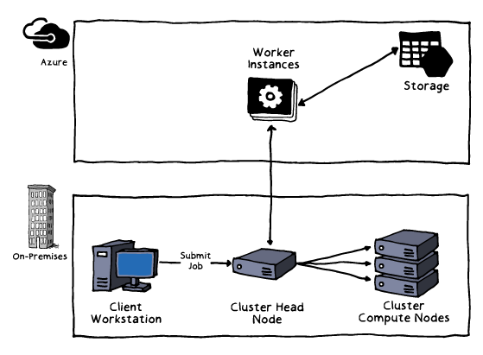
HPC using Microsoft Azure Virtual Machines
Available via Microsoft HPC Pack
Offers cluster and job management capabilities
Consists of a head node (Windows) and compute nodes (Windows or Linux)
Supports “burst to Azure” hybrid scenarios
Benefits from RDMA support of:
H-series VMs (H16r and H16mr):
Intel Haswell-based 16 vCPUs
DDR4 memory
SSD temporary storage
A8 and A9 VM sizes
N-series VMs (designated with “r”)

Slide 5
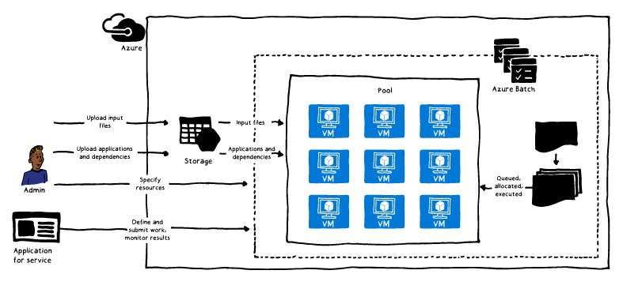
Azure Batch for HPC
PaaS service for large-scale parallel and HPC applications:
Offers autoscaling, automatic node management, and job scheduling
Facilitates scenarios involving end-of-cycle processing, highly scalable apps, and intrinsically parallel workloads e.g.:
Fluid dynamics simulations
Digital content creation
Financial services
Life science research
Image rendering
Supports Batch API

Slide 6
Lesson 2: Implement resilient apps by using queues
High-performance computing (HPC)
HPC using Microsoft Azure Virtual Machines
Azure Batch for HPC

Slide 7
Asynchronous messaging
Facilitates communication in partitioned workloads scenarios
Enables applications and services to communicate and cooperate
Simplifies building scalable and resilient solutions
Supports asynchronous operations
Allows for decoupling consumers and implementers of services

Slide 8
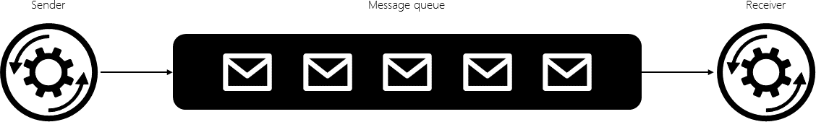
Message queues
Implement asynchronous messaging
Support three fundamental operations:
A sender can post a message to the queue.
A receiver can retrieve a message from the queue (the message is removed from the queue).
A receiver can examine (or peek at) the next available message in the queue (the message is not removed from the queue).

Slide 9
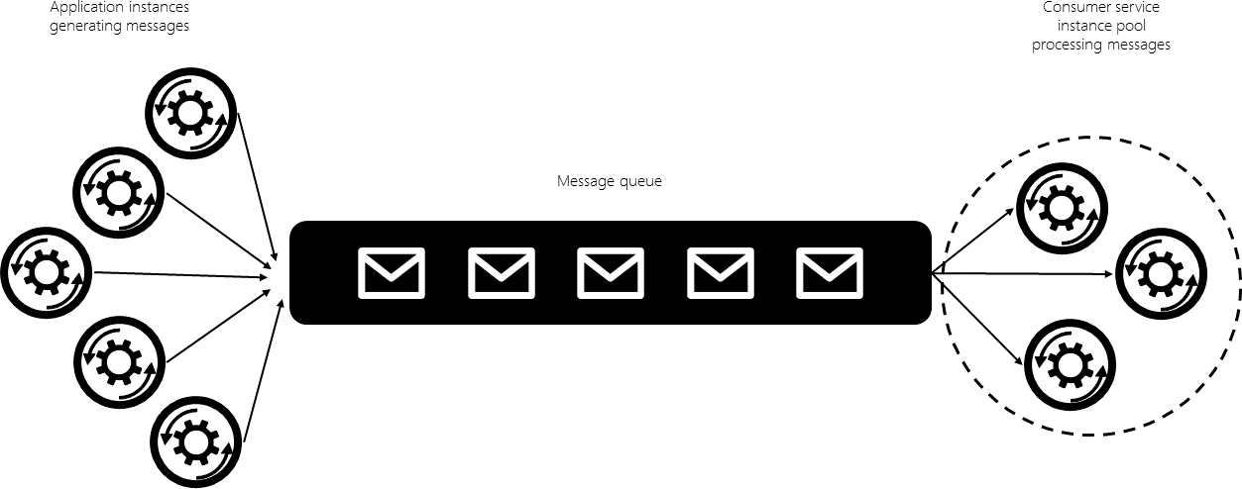
Concurrent queue consumers
Facilitate unpredictable and highly dynamic workloads:
Eliminate the bottleneck associated with a single consumer
Require additional provisions, including:
Coordination among consumers
Load distribution and balancing
Support the use of queues:
Azure Service Bus queues
Azure Storage queues

Slide 10
Using Azure Storage queues in code
Sending a message to a queue:
Create a new CloudQueueMessage
Call the AddMessage method
A CloudQueueMessage can be created from either a string (in UTF-8 format) or a byte array.
Receiving messages from a queue:
Peek at the message in the front of a queue without removing it from the queue by calling the PeekMessage method
Dequeue a message from a queue in two steps (this ensures that if your code fails to process a message due to a hardware or software failure, another instance of your code can get the same message and try again):
Call GetMessage: a message returned from GetMessage becomes invisible to any other code reading messages from this queue. By default, this message stays invisible for 30 seconds.
Call DeleteMessage after the message has been processed to finish removing the message from the queue

Slide 11
Lesson 2: Managing Service Bus
Video: Service Bus
Queues
Topics and Subscriptions
Service Bus Features
Implementing Service Bus
Creating the Namespace
Create a Queue
Monitoring Service Bus
Comparing Service Bus and Storage Queues
Practice: Service Bus Message Queues
Practice: Service Bus Templates

Slide 12
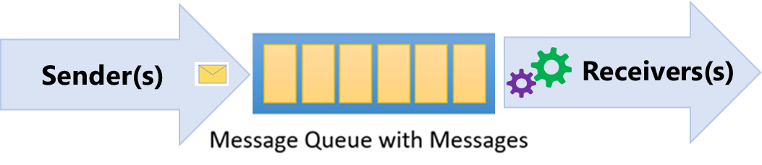
Queues
Azure Service Bus Queues provide:
Asynchronous, brokered messaging
Temporal decoupling of message senders and receivers
Structured message processing
Publish/subscribe capabilities
First In, First Out (FIFO) message delivery

Slide 13
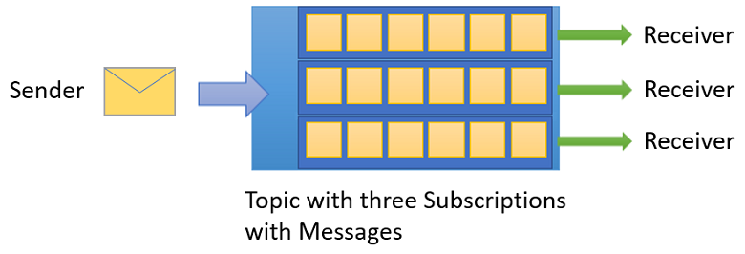
Topics and Subscriptions
One-to-many communication in a publish/subscribe pattern
Useful for scaling large number of recipients
Each published message is available to topic-registered subscriptions
Subscriptions use filters to designate messages to receive

Slide 14
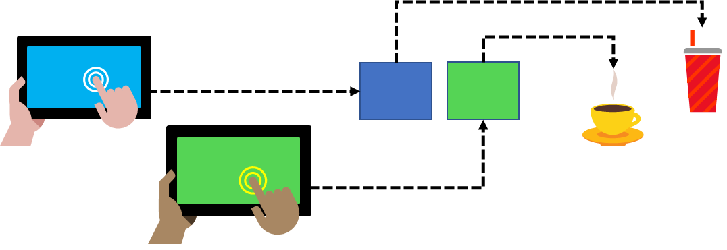
Service Bus Features
Load Leveling
Loose Coupling
Load Balancing

Slide 15
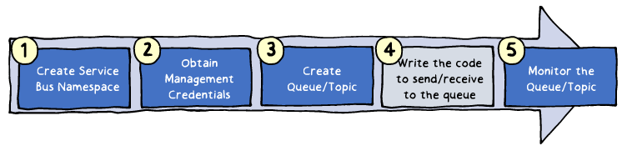
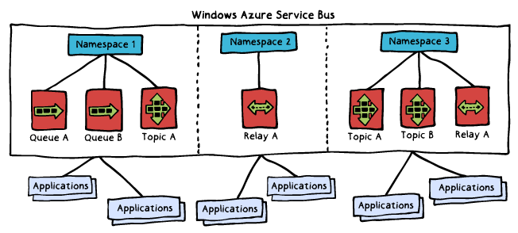
Implementing Service Bus
Implementation steps:
1. Creating a Service Bus namespace
2. Obtaining management credentials
3. Creating queues and topics
4. Writing code to send/receive messages
5. Managing and monitoring queues and topics

Slide 16
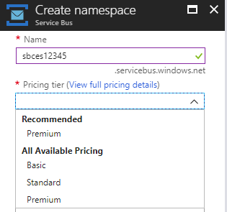
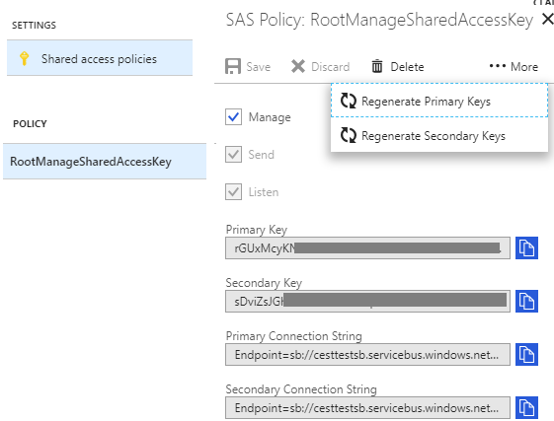
Creating the Namespace
Available directly from the Azure portal:
Name: globally identifies the namespace
Pricing tier: determines capacity and capabilities
Basic
Standard
Premium
Generates a SAS policy:
Includes:
Primary key
Secondary key
Grants full control to the namespace

Slide 17
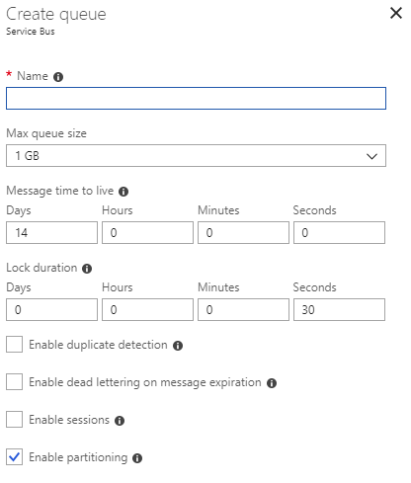
Create a Queue
Available directly from the Azure portal:
Name: identifies the queue within the namespace
Max queue size
Message time to live
Lock duration
Enable duplicate detection
Enable dead lettering
Enable sessions
Enable partitioning

Slide 18
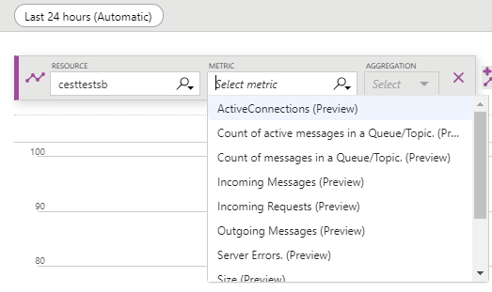
Monitoring Service Bus
Available directly from the Azure portal:
A rich set of metrics:
Namespace level
Queue/topic/message level
Diagnostic logs:
Capture all queue activities

Slide 19
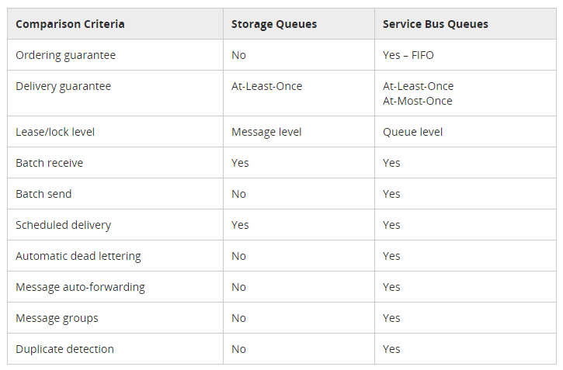
Comparing Service Bus and Storage Queues

